Slide 1
Dodd–Frank Wall Street Reform and Consumer Protection Act
From a presentation by
Fox Rothschild, LLP
www.foxrothschild.com/webinars/webinar_Dodd_Frank_082510.PPT with additional material from Wikipedia and form Morrison Foerster
as published in Bloomberg BNA's International Financial Regulation Review
Krzysztof Ostaszewski, Some comments on systemic risk and Dodd–Frank Act: Wall Street Reform and Consumer Protection Act

Slide 2
A Brief History of Regulation
Regulation # words
Golden Rule 10
Pythangorean Theorem 24
Lord’s Prayer 66
Ten Commandments (KJ) 301
Magna Carta 3,560
US Constitution 7,818
EU Direction of Sale of Duck Eggs 26,911
Dodd Frank Act 202,231

Slide 3
Origins
Financial Crisis led to calls for changes in the regulatory system.
In June 2009, President Obama introduced a proposal for a "sweeping overhaul of the United States financial regulatory system, “
Major components of Obama's original proposal included
The consolidation of regulatory agencies, elimination of the national thrift charter, and new oversight council to evaluate systemic risk;
Comprehensive regulation of markets, increased transparency of derivatives (bringing them onto exchanges);
Consumer protection reforms including a new consumer protection agency and uniform standards for "plain vanilla" products as well as strengthened investor protection;
Tools for financial crises, including a "resolution regime" complementing the existing FDIC authority for orderly wind-down of bankrupt firms, and including a proposal that the Fed receive authorization from Treasury to extend of credit in "unusual or exigent circumstances";
Various measures aimed at increasing international standards and cooperation including proposals related to improved accounting and tightened regulation of rating agencies.
At Obama's request, congress added the Volcker Rule in January 2010.

Slide 4
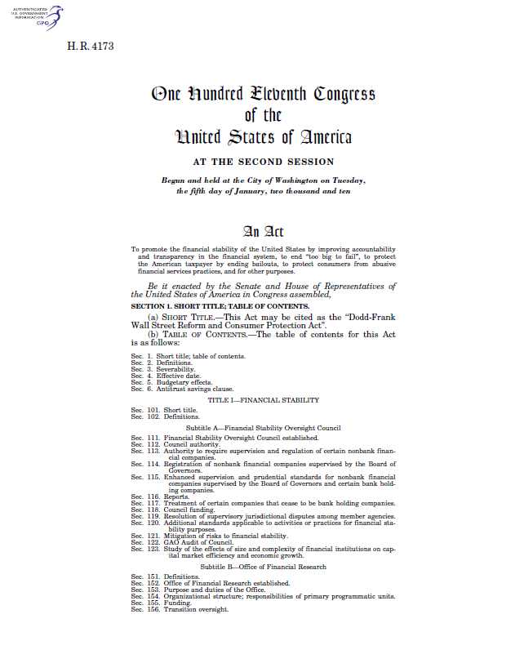
The Act Itself
http://www.sec.gov/about/laws/wallstreetreform-cpa.pdf
Signed into law by President Obama on July 21, 2010
848 pages
16 “Titles”, many “Subtitles”
Law intended to:
improve accountability and transparency
end ‘too big to fail’
protect taxpayers by ending bailouts
protect consumers from abusive practices

Slide 5
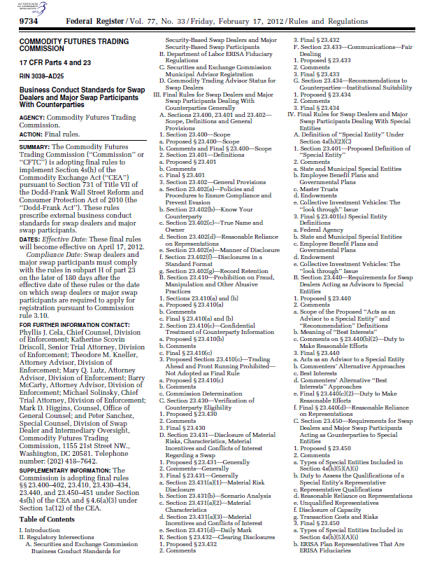
The Rulemaking Process
Laws don’t enact themselves – they require rules to be enforced
Federal agencies are required to publish notices of proposed rulemaking in the Federal Register to enable citizens to participate in the decision making process of the Government.
A proposed rule published in the Federal Register notifies the public of a pending regulation.
Any person or organization may comment on it directly, either in writing, or orally at a hearing. Many agencies also accept comments online or via e-mail. The comment period varies, but it usually is 30, 60, or 90 days. For each notice, the Federal Register gives detailed instructions on how, when, and where a viewpoint may be expressed. In addition, agencies must list the name and telephone number of a person to contact for further information.
When agencies publish final regulations in the Federal Register, they must address the significant issues raised in comments and discuss any changes made in response to them. Agencies also may use the notice and comment process to stay in contact with constituents and to solicit their views on various policy and program issues.
http://www.archives.gov/federal-register/the-federal-register/about.html

Slide 6
The Rulemaking Process
Legislatures rely on rulemaking to add more detailed scientific, economic, or industry expertise to a policy—fleshing out the broader mandates of authorizing legislation.
Common purposes of rulemaking include:
Adding scientific expertise.
Adding implementation detail
Adding industry expertise.
Adding flexibility.
Finding compromise.
The process has been described using terms like “Byzantine” and “tedious” and is inherently political in nature
http://en.wikipedia.org/wiki/Rulemaking,
http://www.propublica.org/article/from-dodd-frank-to-dud

Slide 7
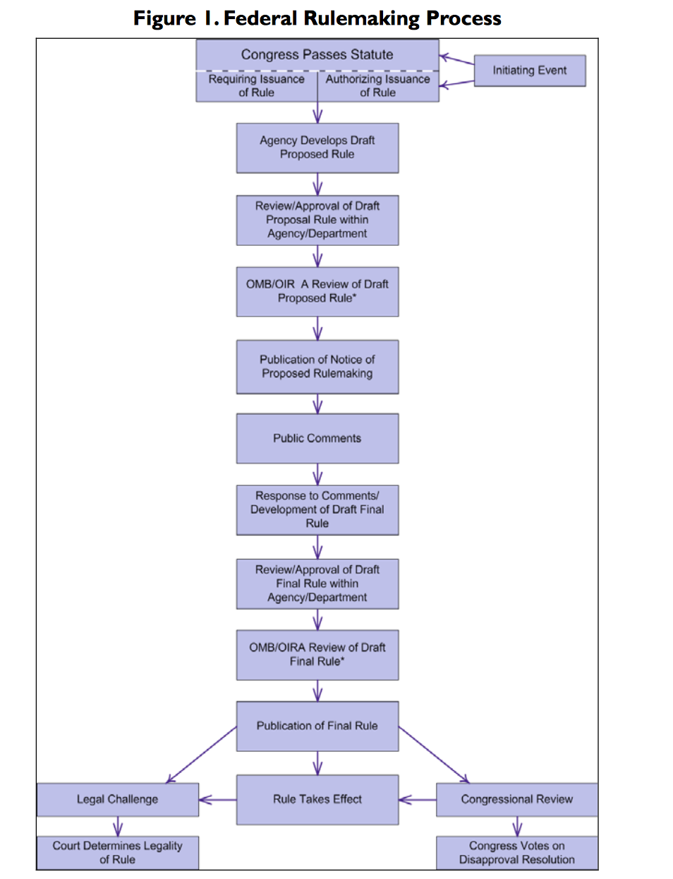
￼
￼

Slide 8
Rulemaking
Figure 1 illustrates basic process most federal agencies generally required to follow in writing /revising a significant rule.
Some do not apply to all rules: An agency may issue a final rule without issuing a NPR, skipping several steps in the figure.
BUT some rules may be published for public comment more than once.
Independent regulatory agencies not required to submit their rules to OMB Office of Information and Regulatory Affairs for review.
No agency required to do so for rules that are not “significant.”
Rulemaking begins when Congress passes statute either requiring or authorizing an agency to write and issue certain types of regulations.
An initiating event (e.g., recommendation from outside body or a catastrophic accident) can prompt legislation or regulation (where regulatory action has already been authorized).
Note also the roles that Congress and courts can play at the end of the process, which may result in a rule being returned to an earlier point in the process or being vacated by the reviewing body.
Congress may also play a role at other stages in the process through its oversight and appropriations responsibilities.
Implicit within steps depicted is an elaborate set of procedures /requirements Congress and various Presidents have developed during the past 60 70 years to guide rulemaking process.
Some rulemaking requirements apply to virtually all federal agencies, some apply only to certain types, and others agency-specific.
Collectively, they are voluminous and require a wide range of procedural, consultative, and analytical actions on the part of rulemaking agencies.
Some contend that requirements have resulted in the “ossification” of the process, causing agencies to take years to develop final rules.
On the other hand, while these requirements are numerous, it is not clear whether they or other factors (e.g., lack of data, congressional delays, court challenges, etc.) are primary cause of the long time-frames sometimes required to develop and publish final rules.

Slide 9
Federal Register
Federal Register Act became law in July 1935
The act established a uniform system for handling agency regulations by requiring
the filing of documents with the Office of the Federal Register,
the placement of documents on public inspection,
publication of the documents in the Federal Register, and
After 1937 amendment, permanent codification of rules in the Code of Federal Regulations.
Publication of a rule in the Federal Register provides official notice of its existence and contents.
Other documents that are generally published in the Federal Register include presidential proclamations and executive orders, notices, and documents that the President or Congress requires to be published.

Slide 10
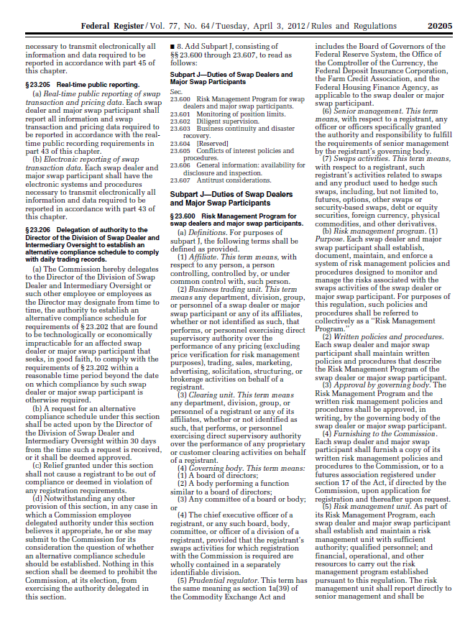

Making Sense of The Federal Register
Better yet, read a law firm’s summary

Slide 11
Dodd-Frank Wall Street Reform and Consumer Protection Act
Still very much a "work-in-progress"
Affects multiple industries and legislation; numerous amendments to existing laws; creates several new laws
Far-reaching consequences -- new rules to be written by federal agencies
Many studies to be conducted (many preceding the rulemaking)
reports to be made to Congress

Slide 12
The Act
The Act is categorized into sixteen titles and by one law firm's count, it requires that regulators create 243 rules, conduct 67 studies, and issue 22 periodic reports.
The Act changes the existing regulatory structure, such as creating new agencies (while merging and removing others) with the objectives being: streamlining the regulatory process, increasing oversight of specific institutions regarded as a systemic risk, amending the Federal Reserve Act, promoting transparency, and some additional.

Slide 13
Provisions
Title I - Financial Stability
Title II - Orderly Liquidation Authority
Title III - Transfer of Powers to the Comptroller, the FDIC, and the FED
Title IV - Regulation of Advisers to Hedge Funds and Others
Title V – Insurance
Title VI - Improvements to Regulation
Title VII - Wall Street Transparency and Accountability
Title VIII - Payment, Clearing and Settlement Supervision

Slide 14
Provisions
Title IX - Investor Protections and Improvements to the Regulation of Securities
Title X - Bureau of Consumer Financial Protection
Title XI - Federal Reserve System Provisions
Title XII - Improving Access to Mainstream Financial Institutions
Title XIII - Pay It Back Act
Title XIV - Mortgage Reform and Anti-Predatory Lending Act
Title XV - Miscellaneous Provisions
Title XVI - Section 1256 Contracts

Slide 15
Title I Financial Stability Act
Creates Financial Stability Oversight Council (FSOC)
identify systemically significant institutions,
regulate them more strictly, regardless if the BHC cease owning an insured institution (avoid reg arb)
Council has 3 purposes:
identify the risks to financial stability of the US from financial and non-financial organizations
promote market discipline, eliminate expectations of bailout
respond to emerging threats to the stability of the US financial system
The Financial Stability Oversight Council has ten voting members:
Secretary of the Treasury (chair) Chairman of the Federal Reserve
Comptroller of the Currency Director Bureau of Consumer Financial Protection
Chair SEC Chair FDIC
Chair CFTC Director FHFA
Chairman NCUAB 5 nonvoting advisory members
1 independent insurance member, appointed by President
Creates Office of Financial Research within Treasury

Slide 16
Title I: Enhanced Prudential Standards
Enhanced Federal Reserve Authority
Subjects systemic risk non-bank financial institutions to Fed supervision and BHCs over $50 billion to enhanced Fed supervision
Systemic risk BHCs and non-bank financial institutions to prepare and report periodically on contingent resolution plans (living wills)
Systemic risk BHCs and non-bank financial institutions to prepare and report periodically on credit exposure reports
Credit exposure limitation for systemic risk BHCs and non-bank financial institutions of 25% of capital to any unaffiliated company
Annual stress tests for systemic risk BHCs and non-bank financial institutions
Early remediation requirements for systemic risk BHCs and non-bank financial institutions to avoid insolvency and harm to financial stability
Required divestiture of activities or assets to mitigate systemic risk
FDIC backup exam and enforcement authority for systemic risk BHCs and non-bank financial institutions
Risk committees required for publicly traded systemic risk BHCs and non-bank financial institutions

Slide 17
Title II Orderly Liquidation Authority
Addresses "too big to fail.”
“Orderly Liquidation Authority" (OLA) allows FDIC to seize financial company whose imminent collapse has been found to threaten the U.S. financial system
FDIC may seize and liquidate under OLA, preempting any proceedings under the Bankruptcy Code
Only liquidation may occur – not reorganization
Establishes Orderly Liquidation Fund,
to be used by FDIC if a covered financial company's liquidation not covered by FDIC or SIPC
has limitations with respect to size
Establishes Orderly Liquidation Authority Panel
three bankruptcy judges drawn from District of Delaware
appointed by the Chief Judge of the United States Bankruptcy Court for the District of Delaware.

Slide 18
Orderly Liquidation Authority
Insurance companies remain state-regulated - may not be so seized and liquidated
Holding companies and unregulated affiliates may
When deciding whether to extend or maintain credit, rating agencies, lenders and other potential creditors must now consider effect of OLA as well as Bankruptcy Code

Slide 19
Orderly Liquidation Authority
In General - FDIC and/or the Federal Reserve
Broker Dealers - SEC and/or the Federal Reserve
Insurance Companies – Federal Insurance Office and/or the Federal Reserve
When financial institution is placed into receivership under these provisions, within 24 hours the Secretary shall report to Congress, and within 60 days there shall be a report to the general public.
Report on recommendation to place company into receivership shall contain details on state of company, impact of default, and proposed action.

Slide 20
Title II Under Trump
Republicans want to abolish Title II of Dodd-Frank
New provisions wouldbe added to the bankruptcy code to handle special public policy needs related to systemic failures.
There is a budgetary cost to parts of Title II, as scored by the CBO, so such a change could potentially be included in a budget reconciliation act, eliminating the possibility of
In practice, elimination of Title II may not affect banks in a big way, outside of a major crisis, as there will still be just as much need for R&R planning and banks already focused heavily on it.
There would, however, be direct and indirect implications for the government’s response to a major crisis and the perception of foreign policymakers as to what those responses would be.

Slide 21
Title III: Transfer of Powers to the Controller of the Currency, the Corporation and the Board of Governors
Enhancing Financial Institution Safety and Soundness Act of 2010
Eliminates OTS
Allocates thrift and thrift holding company oversight responsibilities among the Federal Reserve, FDIC and OCC
Assessments for Deposit Insurance Fund will now be based on total liabilities – not just deposit liabilities
FDIC coverage is extended to $250,000
States that each of the financial regulatory agencies represented on the Council shall establish an Office of Minority and Women Inclusion.

Slide 22
Title IV Regulation of Advisers to Hedge Funds and Others
Private Fund Investment Advisers Registration Act of 2010
Effective 1 year from enactment of Dodd-Frank, eliminates "fewer than 15 clients" exemption most hedge funds and IAs use to avoid SEC registration as investment advisers
Assets under management (AUM) minimum threshold of $25 million that allowed IAs to register with the SEC as opposed to one or more states has been increased to $100 million
New exemptions for "private funds" (with AUM over $150 million), "venture capital funds" and "family office advisers," among other new categories

Slide 23
Title IV: Regulation of Advisers to Hedge Funds and Others
Significant regulation of hedge funds, and other similar investment intermediaries for the first time
Increases record-keeping and reporting obligations for both registered and unregistered IAs
Disallows an "accredited investor" to include the value of his/her "primary residence" in determining whether investor meets the $1 million net-worth test
Authorizes the SEC to adjust the "accredited investor" standards every four years
Limits ability of advisors to exclude information in reporting to various Federal government agencies.
Exemption in reporting for Venture Capital Fund Advisors, certain advisors with assets under management under $150 million, and family offices (as defined by the Commission).

Slide 24
Title V Insurance
Federal Insurance Office Act of 2010
Nonadmitted and Reinsurance Reform Act of 2010
Creates "Federal Insurance Office” within Treasury
Will monitor insurance industry for systemic risks
Negotiate insurance-related agreements with foreign governments
States retain primary authority over U.S. insurers
Monitor extent to which underserved communities and consumers, minorities, and low-and moderate-income persons have access to affordable insurance (except health insurance).
Makerecommendations to the Financial Stability Oversight Council about insurers.

Slide 25
Title VI: Improvements to Regulation of Bank and Savings Association Holding Companies and Depository Institutions
Bank and Savings Association Holding Company and Depository Institution Regulatory Improvements Act of 2010
Heightened regulation, supervision, examination and enforcement powers banks and their subsidiaries, including derivatives and "repos"
Contains "Volcker Rule," prohibiting any "banking entity" from engaging in proprietary trading, or sponsoring or investing in a hedge fund or private equity fund
Volcker Rule watered down with late-added exceptions
Systemically significant non-banks not subject to the Volcker Rule, but incur additional capital requirements and certain limits on their activities

Slide 26
Title VII Wall Street Transparency and Accountability
Wall Street Transparency and Accountability Act of 2010
Regulation of over the counter swaps markets
Gives SEC and CFTC primary authority over swaps markets
Requires certain swaps be exchange-traded, centrally cleared and publicly reported
Definition of "swap" is left open to review and amendment, as are many other related aspects

Slide 27
Title VII - Wall Street Transparency and Accountability
Regulators required to consult with each other before implementing any rule-making or issuing orders regarding several different types of security swaps.
Repeals exemption from regulation for security-based swaps under the Gramm-Leach-Bliley Act.
Provides that, "Except as provided otherwise, no Federal assistance may be provided to any swaps entity with respect to any swap, security-based swap, or other activity of the swaps entity.”
"Interagency Group" is constituted to oversight of carbon markets to ensure an efficient, secure, and transparent carbon market, including oversight of spot markets and derivative markets.

Slide 28
Title VIII Payment, Clearing and Settlement Supervision
Payment, Clearing and Settlement Supervision Act of 2010
Grants Federal Reserve (and SEC and CFTC) new authority and responsibility for systemically significant "financial market utilities" and various clearing entities

Slide 29
Title IX Investor Protections and Improvements to the Regulation of Securities
Investor Protection and Securities Reform Act of 2010
Impacts broker-dealers, investment advisers, credit rating agencies, structured finance products and executive compensation and corporate governance
Applies to all public companies, not just financial institutions
To prevent regulatory capture within SEC and increase influence of investors, Act creates Office of the Investor Advocate, an Investor Advisory Committee composed of 12-22 members who serve 4-year terms, and ombudsman appointed by the Office of the Investor Advocate
Bolsters whistle-blower awards and protections
Authorizes monetary penalties in cease-and-desist proceedings

Slide 30
Title IX Investor Protections and Improvements to the Regulation of Securities
For broker-dealers and IAs, SEC to conduct studies regarding customer issues and impose new rules
including a likely new "fiduciary duty" for brokers regarding retail customers, instead of current, lesser "suitability" standard
Rating agencies will undergo significant reform to eliminate conflicts of interest and increase accountability and transparency, especially regarding ABS
Executive compensation and corporate governance
Mandates non-binding shareholder votes on compensation and golden parachutes
Requires independence of compensation committees
Disclosures of executive compensation, incentive-based compensation and chairman-CEO relationships; and "clawbacks" of erroneously awarded compensation
Limits broker voting and increases proxy access for shareholders

Slide 31
Title IX, Subtitle C
Mandates creation by SEC of Office of Credit Ratings (OCR) to provide oversight over nationally recognized statistical rating organizations (NRSRO) and enhanced regulation
Grants authority to the SEC to suspend /revoke registration of wrt particular classes of securities if after notice /hearings NRSRO lacks resources to produce ratings with integrity.
SEC prescribes rules with respect to credit rating procedures and methodologies.
OCR is required to conduct an examination of each NRSRO at least annually, produce inspection report.
SEC will require NRSROs to disclose information on credit ratings issued, including methodology and data relied on, to enable users to evaluate NRSROs.

Slide 32
Title IX, Subtitle C
SEC prescribes rules with respect to credit rating procedures and methodologies.
OCR is required to conduct an examination of each NRSRO at least annually and shall produce a public inspection report.
SEC will require NRSROs to publicly disclose information on initial and revised credit ratings issued, including the credit rating methodology utilized and data relied on, to enable users to evaluate NRSROs.

Slide 33
Title IX, Subtitle C, NRSROs
NRSROs required to maintain and document effective internal control structure
Submit to the OCR an annual internal control report.
Adhere to rules established by Commission to prevent marketing conflict from influencing ratings.
Policies and procedures wrt to employment transitions to avoid conflicts, the processing of complaints regarding NRSRO noncompliance, and notification to users of identified significant errors are required.
Compensation of the compliance officer may not be linked to the financial performance of the NRSRO.

Slide 34
Title IX, Subtitle D
Improvements to the ABS Process
Regulations for resi assets jointly prescribed by SEC, the Secretary of HUD, and the FHFA
Otherwise by Banking agencies and SEC.
Securitizers are:
Prohibited from hedging or transferring the credit risk it is required to retain with respect to the assets.
Required to retain not less than 5% of the credit risk for an asset that is not a qualified residential mortgage,
for commercial mortgages or other types of assets, regulations may provide for retention of less than 5% of the credit risk, provided that there is also disclosure.

Slide 35
Title IX, Subtitle E, Accountability and Executive Compensation
National securities exchanges required to prohibit the listing of any issuer not in compliance with requirements of compensation sections.
At least once every 3 years, a corporation required to submit to shareholder vote the approval of executive compensation.
Once every 6 years there should be shareholder vote whether approval of executive compensation should be more often
Shareholders may disapprove Golden Parachute comp via non binding vote.
Shareholders must be informed of relationship between executive comp paid and financial performance of issuer, taking into account any change in value of shares dividends.

Slide 36
Title IX, Subtitle E, Accountability and Executive Compensation
Must disclose to shareholders:
the median of annual total comp of all employees, except CEO
the annual total comp of CEO.
the ratio of median of annual total with the total CEO compensation.
whether any employee or member of the board permitted to purchase share hedge instruments
Compensation Committee must be independent.

Slide 37
Title IX, Subtitle E, Accountability and Executive Compensation
Federal regulators will proscribe regulations that a covered company shall disclose to the appropriate Federal regulator, all incentive-based compensation arrangements with sufficient information such that the regulator may determine whether the compensation package could lead to material financial loss to the company, and whether it provides the employee/officer with excessive compensation, fees, or benefits.

Slide 38
Title X Bureau of Consumer Financial Protection
Consumer Financial Protection Act of 2010
Establishes Bureau of Consumer Financial Protection (BCFP) within the Federal Reserve
Consumers’ watchdog
Authority to write and enforce rules regarding mortgages, credit cards, credit scores and other consumer products
Examination and enforcement authority will only extend over very large banks and non-bank financial institutions
No authority over insured depository institutions and credit unions with assets of $10 billion or less
Also caps credit card fees
Excluded businesses will include retailers, accountants, real estate brokers, lawyers and auto dealers

Slide 39
Bureau of Consumer Financial Protection
Created and vested with broad powers to:
oversee consumer protection for all financial services
reduce gaps in federal supervision and enforcement
improve coordination between federal and state agencies
set higher standards for intermediaries
promote consistent regulation of similar products; and
be “self funding”
regulate consumer financial products and services such as credit, savings and payment products and related services
supervise compliance by banks with consumer regulations
Will coordinate activities with other agencies eg SEC, FTC, and CFTC
Has authority to investigate and respond to consumer complaints

Slide 40
Bureau Subdivisions
Office of Fair Lending and Equal Opportunity
Office of Financial Education
Office of Service Member Affairs
Office of Financial Protection of Older Americans

Slide 41
Bureau Additional Responsibilities
Research and collect date regarding compliance by providers and education of consumers
Monitor risks to consumers of various financial products
Require, review and approval of disclosures and other communications - “no action” letters
Restrict or ban mandatory arbitration clauses;
Define standards for “plain vanilla” products
Must report to Congress at each session

Slide 42
Title XI Federal Reserve System Provisions
The Fed is required to establish prudent standards for the institutions they supervise that include:
Risk-Based Capital Requirements and Leverage Limits
Liquidity requirements;
Overall risk management requirements;
Resolution plan and credit exposure report requirements; and
Concentration limits.
Act limits Federal Reserve emergency lending authority
Act permits GAO to audit recent financial crisis lending as well as future emergency and discount window lending and open-market transactions

Slide 43
Title XII: Improving Access for Mainstream Financial Institutions
Incentives that encourage low and medium-income people to participate in the financial systems
to enable low- and moderate-income individuals to establish one or more accounts in a federal insured bank
make micro loans, typically under $2,500
provide financial education and counseling

Slide 44
Title XIII Pay It Back Act
Reduces TARP funds from $700 billion to $475 billion
Prohibits new TARP funding programs
Requires certain repaid TARP funds to reduce the deficit
Prohibits recycling repaid funds back into the program

Slide 45
Title XIV Mortgage Reform and Anti-Predatory Lending Act
Expand and Preserve Home Ownership Through Counseling Act
Require increased disclosure upon origination of residential mortgage loans, and significantly increases regulation of mortgage loan origination and servicing
Originators will have registration requirements, and must make good faith determinations about the ability of a consumer to repay
"Steering" incentives will be prohibited (e.g., "steering" a consumer to loans with higher fees)
New caps on late fees
Government will make $1 billion available to borrowers to help pay their mortgages ($50,000 cap per homeowner)
Another $1 billion to local governments to redevelop foreclosed and abandoned homes

Slide 46
Title XIV - Mortgage Reform and Anti-Predatory Lending Act
To be administered by the newly established Bureau of Financial Consumer Protection.
Subtitle A - Residential Mortgage Loan Organization Standards.
Subtitle B - Minimum Standards for Mortgages.
Subtitle C - High-Cost Mortgages.
Subtitle D - Office of Housing Counseling.
Subtitle E - Mortgage Servicing.
Subtitle F - Appraisal Activities.
Subtitle G - Mortgage Resolution and Modification.

Slide 47
Title XV Miscellaneous Provisions
Miscellaneous sections regarding
IMF loan policy
Disclosures regarding Congo minerals
Safety reporting for coal mines
Resource extractors to disclose payments to foreign or U.S. governments
Assessment of effectiveness of federal inspectors' general
Study of deposits at banks

Slide 48
Title XVI Section 1256 Contracts
Refers to a section of the IRC §1256
Addresses tax treatment for any regulated futures contract, foreign currency contract or non-equity option
To calculate capital gains or losses, these trades have traditionally been MTM on last business day of the year
Certain securities excluded from this

Slide 49
Key issues in Dodd-Frank
Systemic risk oversight.
Supervision and liquidation of failed institutions that were considered to be too big to fail in the past.
Regulatory restructuring and increased regulatory powers.
Fannie Mae and Freddie Mac largely escaped reform
Bureau of Consumer Financial Protection, other consumer protections.
Volcker Rule.
No additional congressional for SEC to take on new duties.
Treasury and Fed exempt from swap margin requirement, but non-U.S. central banks are not: source of controversy.
Dodd-Frank being implemented far more slowly than Congress intended.

Slide 50
New agencies created
Financial Stability Oversight Council
Office of Financial Research
Bureau of Consumer Financial Protection.

